Slide 1
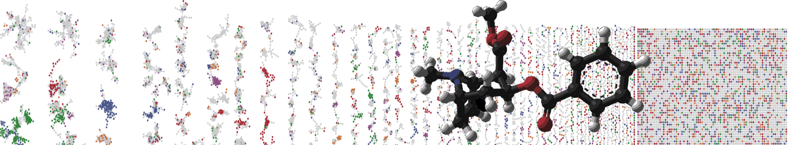


Exporting Molecular Networks to Cytoscape
HANDS ON
ENTER AUTHORS HERE
University of California - San Diego

Slide 2
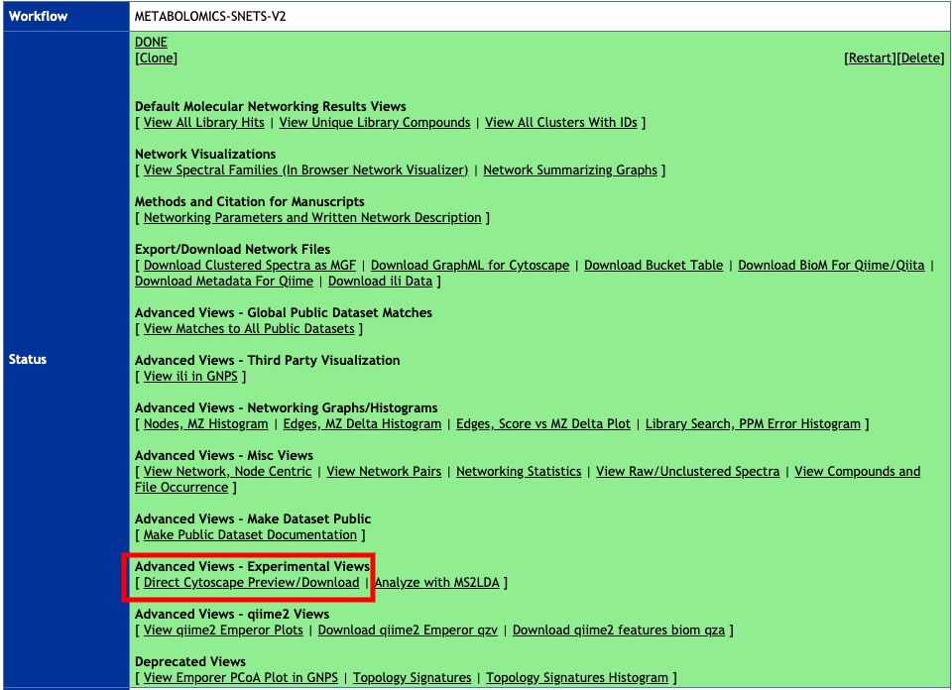
Quick Export (Beta Feature)

Slide 3
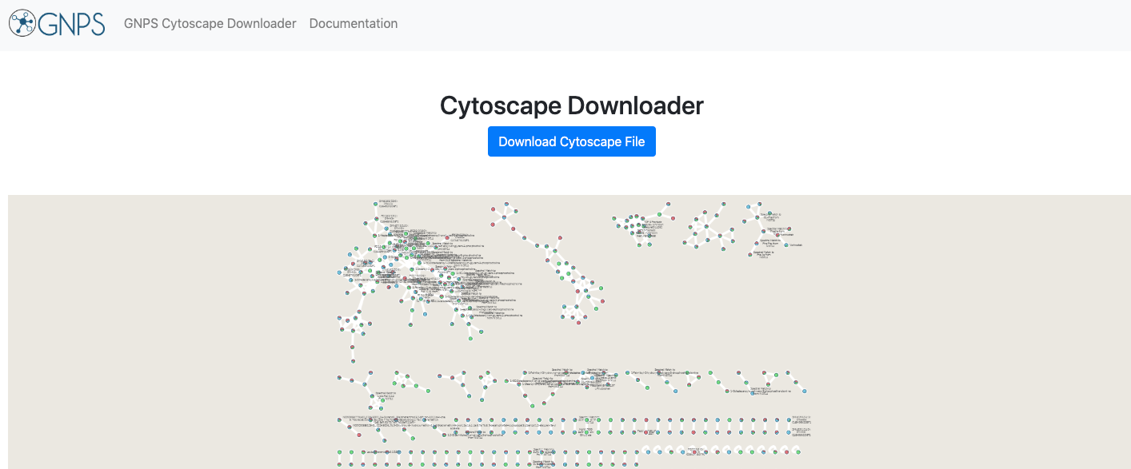
Quick Export (Beta Feature)
Interactive Link

Slide 4

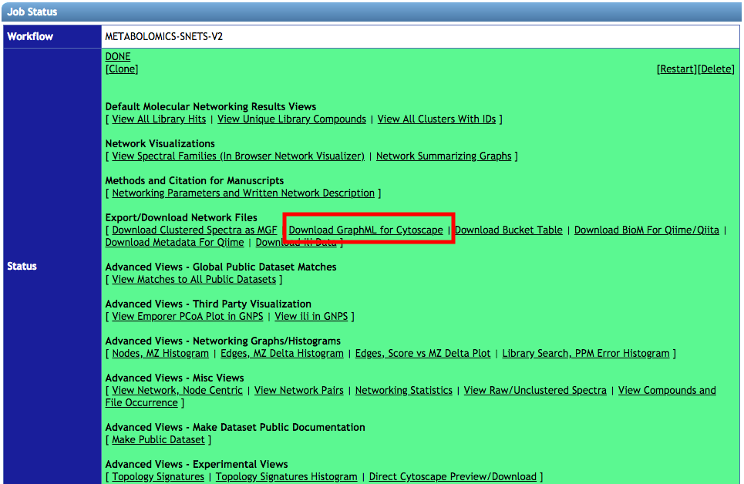

Explore Entire Network in Cytoscape
Non-interactive Slide

Slide 5
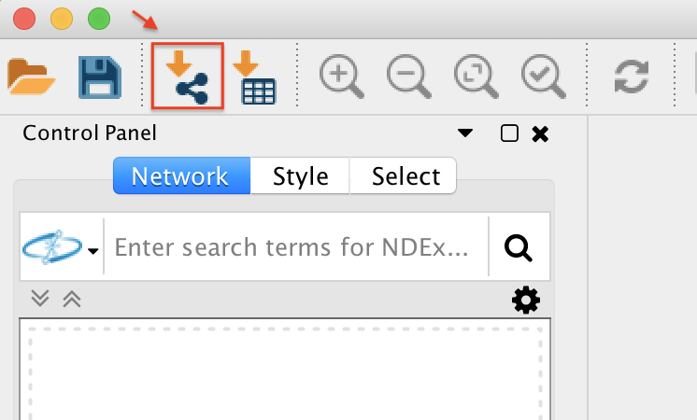
Explore Entire Network in Cytoscape
Non-interactive Slide
Import Network
into Cytoscape

Slide 6
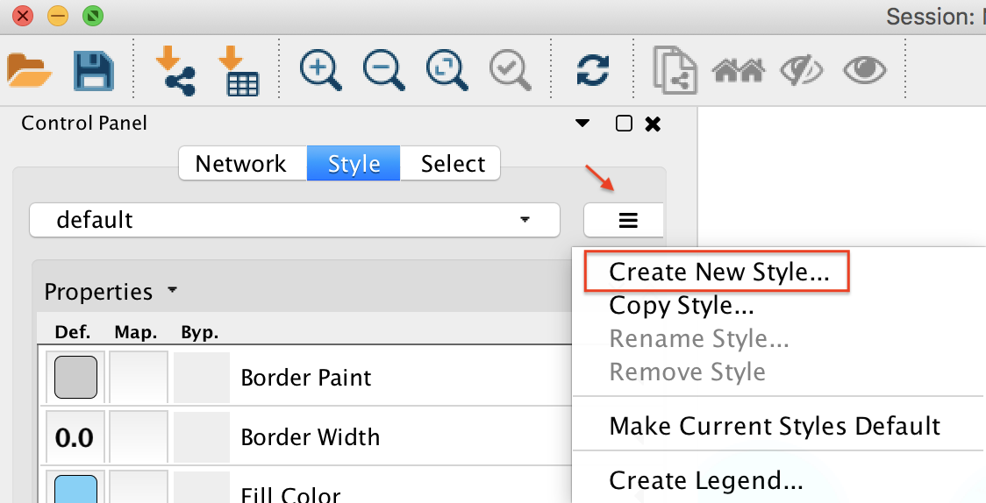
Explore Entire Network in Cytoscape
Non-interactive Slide
Style Network

Slide 7
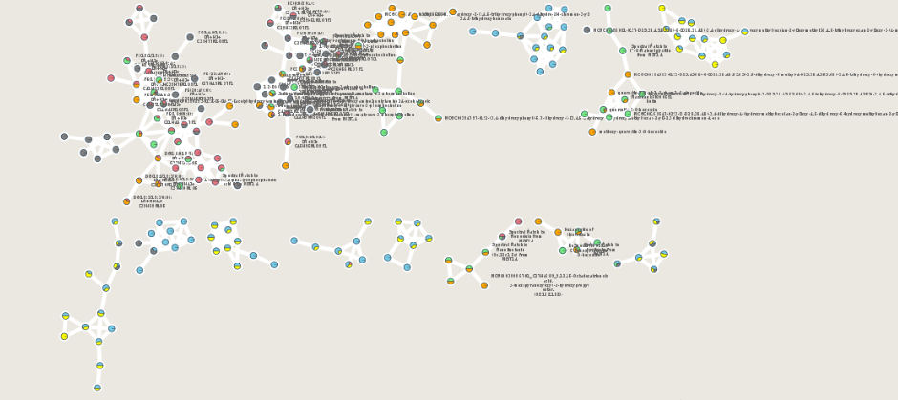
Explore Entire Network in Cytoscape
Non-interactive Slide
Documentation

